Slide 1

Mathematics for Programming

Slide 2
Necessary recap
Real number, Integer, Natural number and more
Divisor, dividend, quotient, remainder
Factor
Prime number
Even vs odd

Slide 3
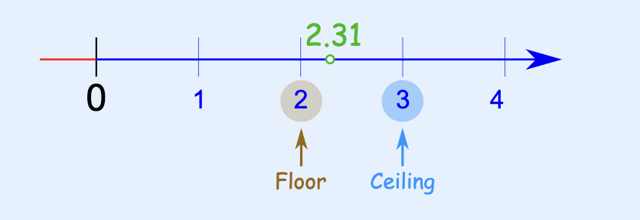

Floor, ceiling, round!
Floor: Nearest integer below
Ceiling: Nearest integer above
Round: Nearest integer
$12.65 →$Floor: $12$, Ceiling: $13$, Round: $13$
$9.21→$Floor: $9$, Ceiling: $10$, Round: $9$
$24→$Floor: $24$, Ceiling: $24$, Round: $24$

Slide 4
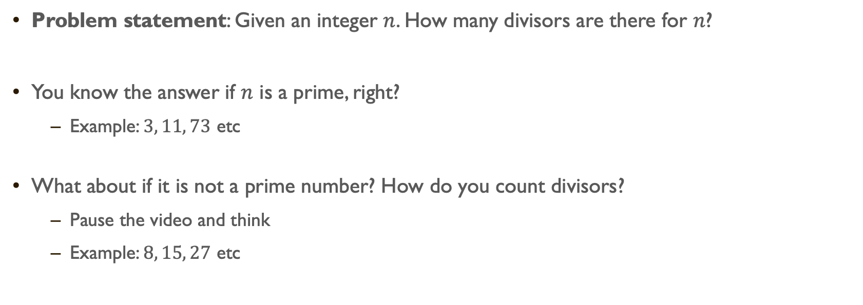
Divisor counting
Problem statement: Given an integer $n$. How many divisors are there for $n$?
You know the answer if $n$ is a prime, right?
Example: $3, 11, 73$ etc
What about if it is not a prime number? How do you count divisors?
Pause the video and think
Example: $8, 15, 27$ etc

Slide 5

Divisor counting – naive
Take all the integers ($1$ to $n$) and test if remainder is 0.
Example: Let’s take $12$
The divisors: $1, 2, 3, 4, 6, 12.$
Number of divisors: $6$
1 | 12%1=0 | √
2 | 12%2=0 | √
3 | 12%3=0 | √
4 | 12%4=0 | √
5 | 12%5=2 | x
6 | 12%6=0 | √
7 | 12%7=5 | x
8 | 12%8=4 | x
9 | 12%9=3 | x
10 | 12%10=2 | x
11 | 12%11=1 | x
12 | 12%12=0 | √

Slide 6

Divisor counting – better?
We already know $1$ and $n$ will be there!
So, $2$ to $(n−1)$ need to be tested.
But … look at the second half!
We only need to check for $2$ to $n/2$
What about odd $n$?
1 | 12%1=0 | √
2 | 12%2=0 | √
3 | 12%3=0 | √
4 | 12%4=0 | √
5 | 12%5=2 | x
6 | 12%6=0 | √
7 | 12%7=5 | x
8 | 12%8=4 | x
9 | 12%9=3 | x
10 | 12%10=2 | x
11 | 12%11=1 | x
12 | 12%12=0 | √

Slide 7

Divisor counting – even better?
Could you stop earlier than $6$?
Yes!
$12\%2 = 0$means $12/2 = 6$also divides $12$
Same goes for $3$ and $4$
So, we could stop at $3$ and still identify all the divisors!
1 | 12%1=0 | √
2 | 12%2=0 | √
3 | 12%3=0 | √
4 | 12%4=0 | √
5 | 12%5=2 | x
6 | 12%6=0 | √
7 | 12%7=5 | x
8 | 12%8=4 | x
9 | 12%9=3 | x
10 | 12%10=2 | x
11 | 12%11=1 | x
12 | 12%12=0 | √

Slide 8

Divisor counting – even better?
Then where do I stop?
For 12, we stopped at 3.
Let’s look at 16
1 x 16 = 16
2 x 8 = 16
4 x 4 = 16
8 x 2 = 16
16 x 1 = 16
So, we do not need to test any number greater than $√n$
$\sqrt{12}=3.464…, \sqrt{16}=4$

Slide 9
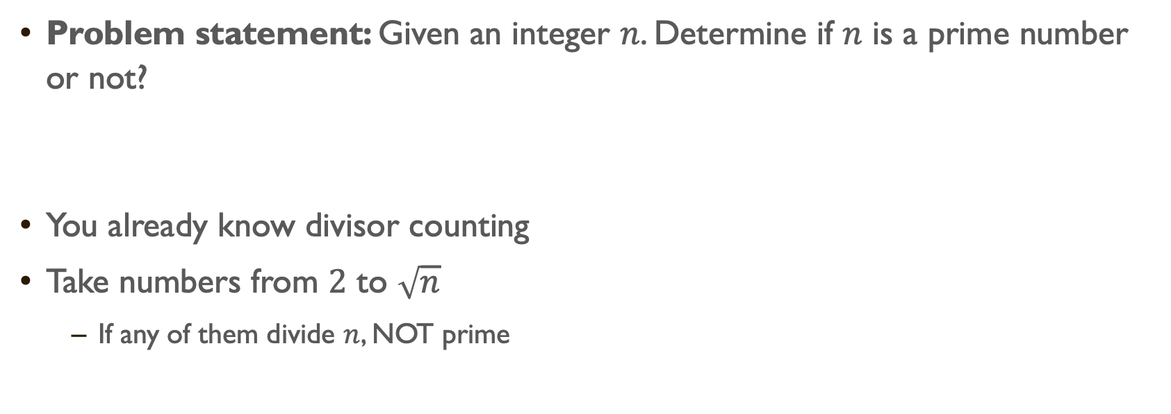
Primality test
Problem statement: Given an integer $n$. Determine if $n$ is a prime number or not?
You already know divisor counting
Take numbers from $2$ to $\sqrt{n}$
If any of them divide $n$, NOT prime

Slide 10
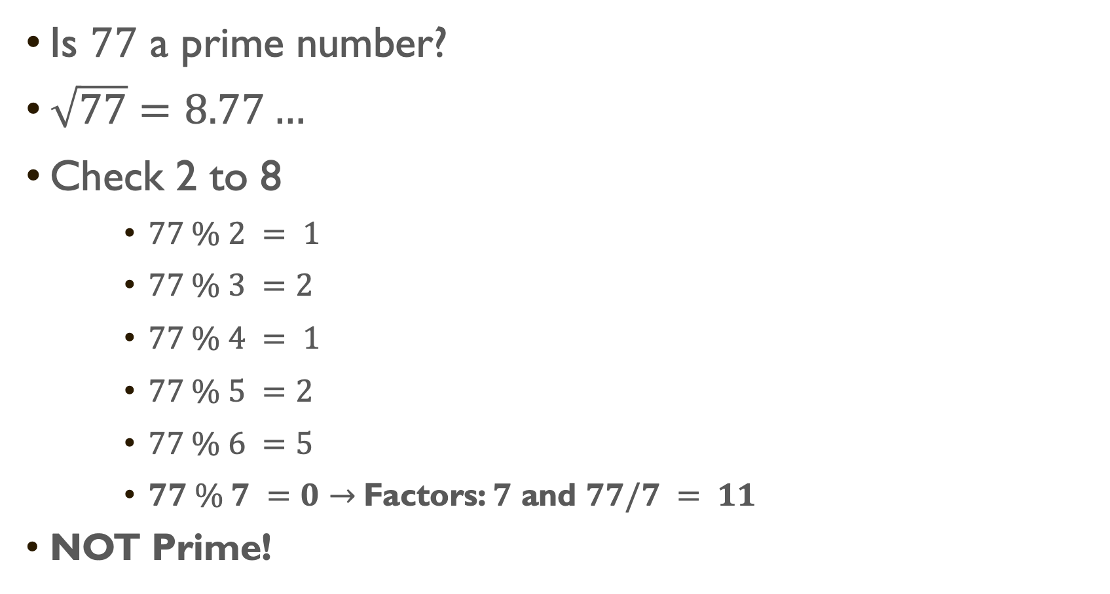
Primality test
Is $77$ a prime number?
$\sqrt{77}=8.77…$
Check 2 to 8
$77 \% 2 = 1$
$77 \% 3 =2$
$77 \% 4 = 1$
$77 \% 5 =2$
$77 \% 6 =5$
$77 \% 7 =0→$Factors: $7$ and $77/7 = 11$
NOT Prime!

Slide 11
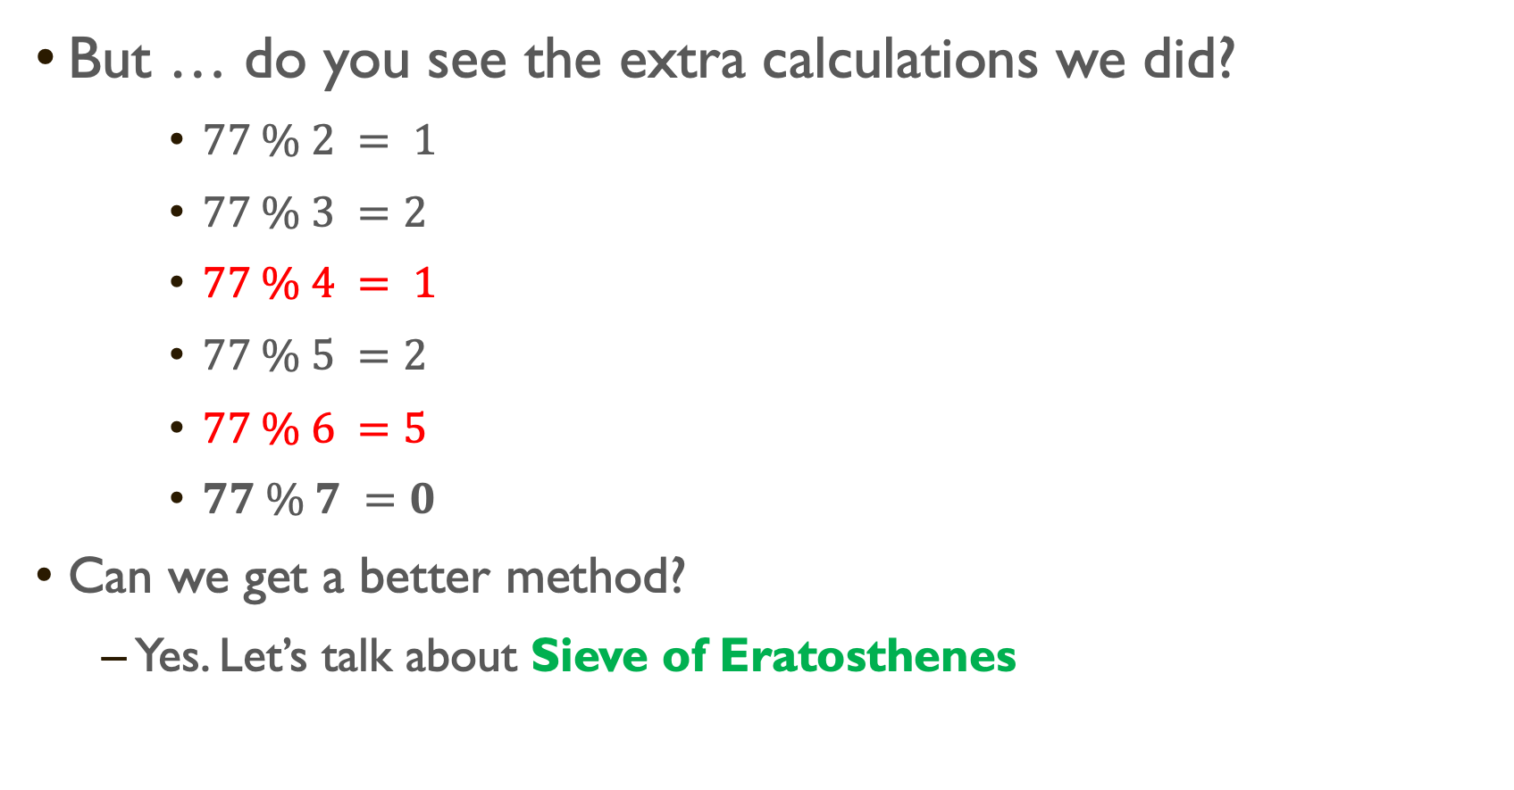
Primality test
But … do you see the extra calculations we did?
$77 \% 2 = 1$
$77 \% 3 =2$
$77 \% 4 = 1$
$77 \% 5 =2$
$77 \% 6 =5$
$77 \% 7 =0$
Can we get a better method?
Yes. Let’s talk about Sieve of Eratosthenes

Slide 12
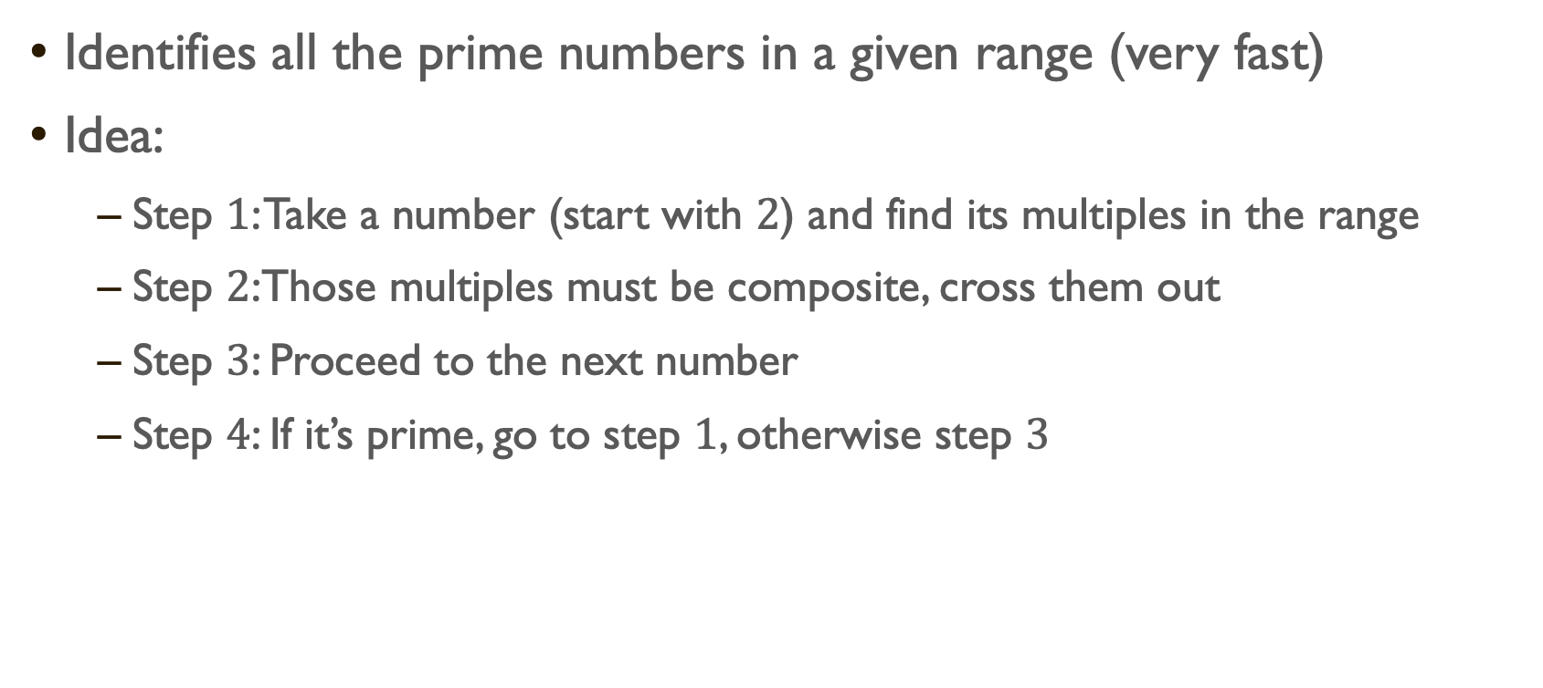
Sieve of Eratosthenes
Identifies all the prime numbers in a given range (very fast)
Idea:
Step $1$: Take a number (start with $2$) and find its multiples in the range
Step $2$:Those multiples must be composite, cross them out
Step $3$: Proceed to the next number
Step $4$: If it’s prime, go to step $1$, otherwise step $3$

Slide 13

Sieve of Eratosthenes
Find out all the prime numbers between $1 to 100$
1 | 2 | 3 | 4 | 5 | 6 | 7 | 8 | 9 | 10
11 | 12 | 13 | 14 | 15 | 16 | 17 | 18 | 19 | 20
21 | 22 | 23 | 24 | 25 | 26 | 27 | 28 | 29 | 30
31 | 32 | 33 | 34 | 35 | 36 | 37 | 38 | 39 | 40
41 | 42 | 43 | 44 | 45 | 46 | 47 | 48 | 49 | 50
51 | 52 | 53 | 54 | 55 | 56 | 57 | 58 | 59 | 60
61 | 62 | 63 | 64 | 65 | 66 | 67 | 68 | 69 | 70
71 | 72 | 73 | 74 | 75 | 76 | 77 | 78 | 79 | 80
81 | 82 | 83 | 84 | 85 | 86 | 87 | 88 | 89 | 90
91 | 92 | 93 | 94 | 95 | 96 | 97 | 98 | 99 | 100

Slide 14

Sieve of Eratosthenes
Find out all the prime numbers between $1 to 120$

Slide 15
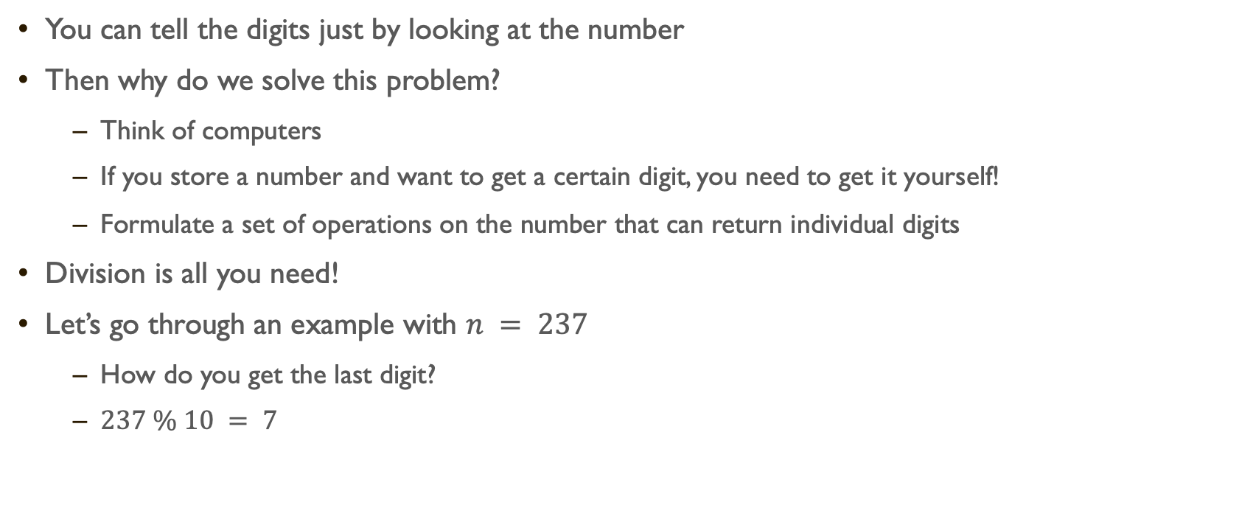
Extract digits from an integer
You can tell the digits just by looking at the number
Then why do we solve this problem?
Think of computers
If you store a number and want to get a certain digit, you need to get it yourself!
Formulate a set of operations on the number that can return individual digits
Division is all you need!
Let’s go through an example with $n = 237$
How do you get the last digit?
$237 \% 10 = 7$

Slide 16
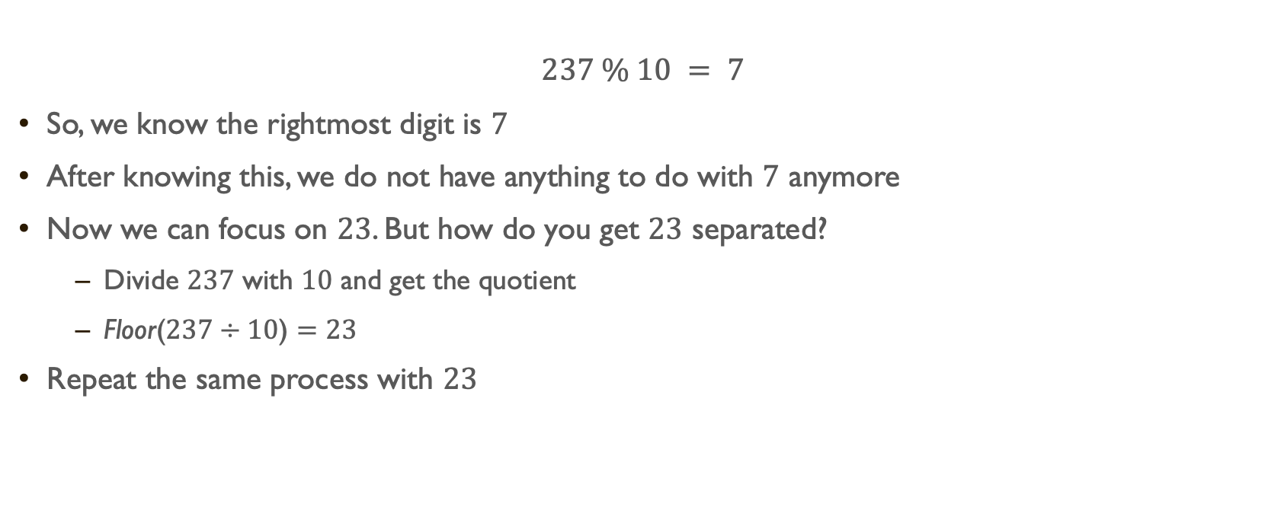
Extract digits from an integer
$$237 \% 10 = 7$$
So, we know the rightmost digit is $7$
After knowing this, we do not have anything to do with $7$ anymore
Now we can focus on $23$. But how do you get $23$ separated?
Divide $237$ with $10$ and get the quotient
Floor($237÷10$) $=23$
Repeat the same process with $23$

Slide 17
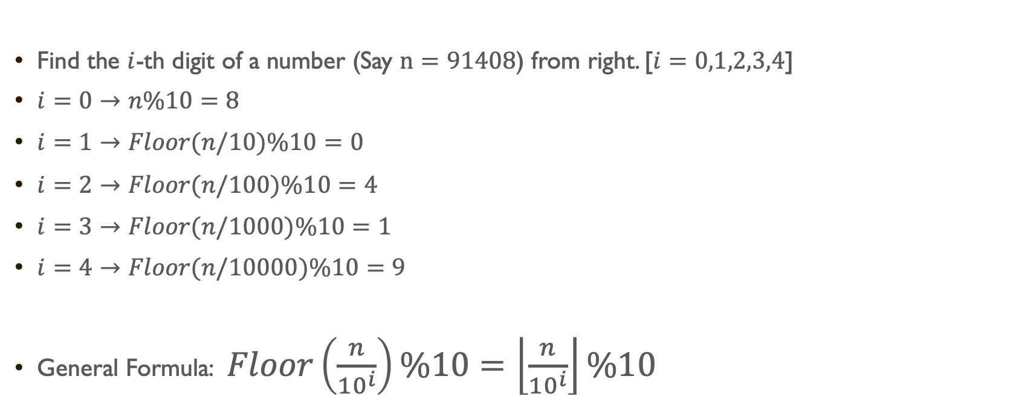
Extract digits from an integer
Find the $i$-th digit of a number (Say $n=91408$) from right. [$i=0,1,2,3,4$]
$i=0→n\%10=8$
$i=1→Floor(n/10)\%10=0$
$i=2→Floor(n/100)\%10=4$
$i=3→Floor(n/1000)\%10=1$
$i=4→Floor(n/10000)\%10=9$
General Formula: $Floor\left(\frac{n}{{10}^{i}}\right)\%10=\left\lfloor \frac{n}{{10}^{i}}\right\rfloor \%10$

Slide 18
Summary
Floor vs Ceiling
Counting number of divisors
Improving our method
Prime number check
Sieve of Eratosthenes
Digit extraction

Slide 21
Practice Day

